Slide 1



Exhaustive Analysis of the
Indian Agriculture Sector

Slide 2

Learning Objectives
1. Understand Agricultural Diversity
Sea Explore the diversity of crop cultivation across Indian states and analyze trends that influence agricultural practices.
2. sonal Insights Analyze how different seasons affect crop production and performance.
3. Performance Patterns Identify the top-performing states and crops based on production metrics to help improve farming strategies and resource allocation.
4. Interactive Decision-Making Equip stakeholders with a data-driven dashboard for customized exploration of agricultural trends.
GOAL
Source :
www.freepik.com/

Slide 3
Tools and Technology used
1. Power BI:
For creating interactive dashboards and detailed visualizations.
2. Data Sources:
MySQL, Excel, CSV files containing agricultural statistics.
3. Technology Stack:
Data preprocessing tools like Python or Excel for cleaning and organizing data.
Power Query for transformation within Power BI.

Slide 4
Methodology
1. Data Collection:
Gathered agricultural data related to states, crops, seasons, and yields from reliable sources.
2. Data Preprocessing: Cleaned, formatted, and standardized the data for consistent and accurate visualization.
3. Dashboard Development:
Designed and developed a Power BI dashboard with filters (State, Season, Crop) for ease of use.
4. Insight Extraction: Used interactive graphs, charts, and KPIs to highlight significant trends and insights.

Slide 5
Problem Statement:
"India's agriculture sector is complex, with diverse cropping patterns and regional variations, making it challenging to derive actionable insights for policy and farming practices.“
Key Challenges:
Limited understanding of how seasonal changes impact crops across different states.
Inconsistent and fragmented data sources hinder comprehensive analysis.
Lack of user-friendly tools to facilitate real-time decision-making.

Slide 6
Solution:
An interactive Power BI dashboard that provides:
Filters for customized analysis by State, Season, and Crop, allowing users to drill down into specific regions or crops of interest.
2.Visual Summaries like bar charts, line graphs, and KPIs showcasing production trends, top-performing states, and crop performance.
Insights for Stakeholders:
Farmers can identify optimal crops for specific seasons.
2. Policymakers can prioritize investments based on state-wise performance.

Slide 7
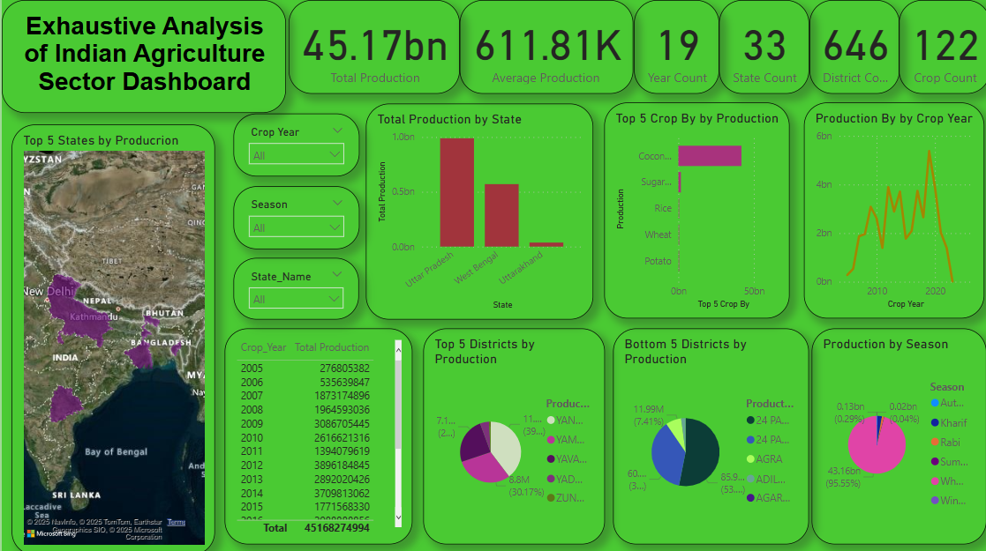
Screenshot of Output:

Slide 8
Conclusion:
"This project provides a robust analysis of the Indian agriculture sector, delivering actionable insights to stakeholders and improving decision-making capabilities.“
Key Takeaways:
Seasonal patterns significantly influence crop performance.
2.Certain states consistently outperform others in specific crops due to better resource management and favorable climates.
3.The interactive dashboard empowers users to explore data based on their unique requirements, facilitating targeted decision-making.
4.This analysis paves the way for optimizing agricultural practices and improving overall productivity.

